Slide 1
Software Testing
NITIN Kumar GAUR
EMP ID :6168
BATCH-89
DATE :22-09-2021

Slide 2
What is testing
Software Testing is a Process of finding errors or bugs in a Software.
Categories in Software Testing
Manual Testing
Automation Testing

Slide 3
Level of testing
Unit Testing
Integration Testing
System Testing
Acceptance

Slide 4
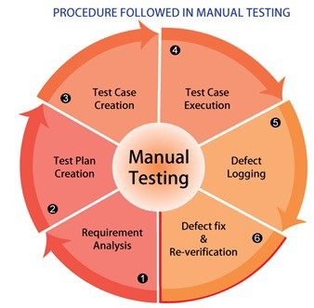
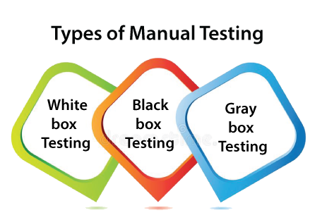
1.What is manual testing
Manual testing is the process of manually testing software for defects.
It requires a tester to play the role of an end user whereby they use most of the application's features to ensure correct behavior.
Basic procedure
Types of manual testing

Slide 5
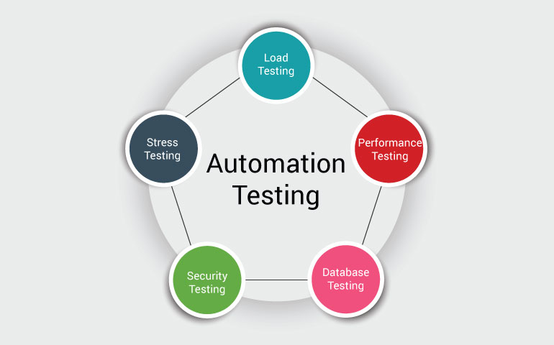
2.Automation testing
Unit testing
Smoke testing
Integration testing
Regression testing
API testing
Security testing
Performance testing
Life cycle of automation testing

Slide 6
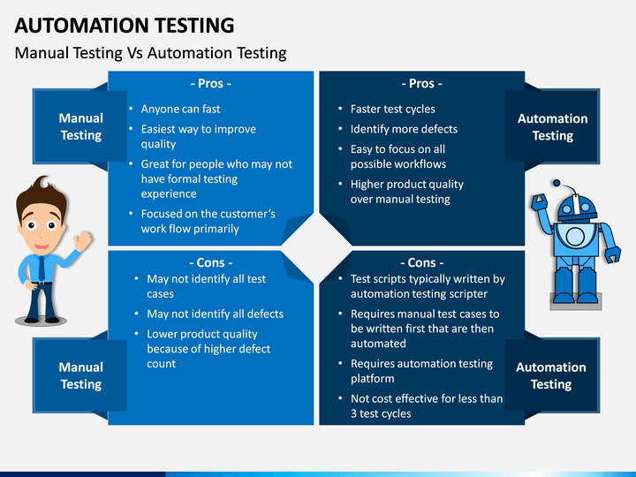
Comparison of manual testing and automation testting

